Slide 1
Object Oriented Programming II
Monday 10th December 2024

Slide 2
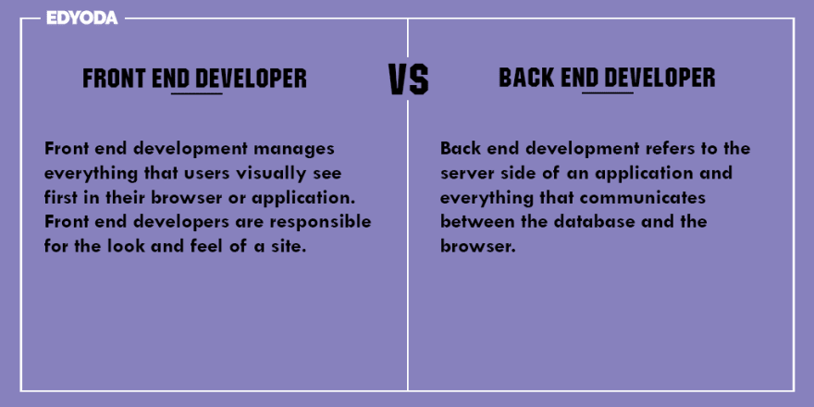
Frontend vs Backend

Slide 3
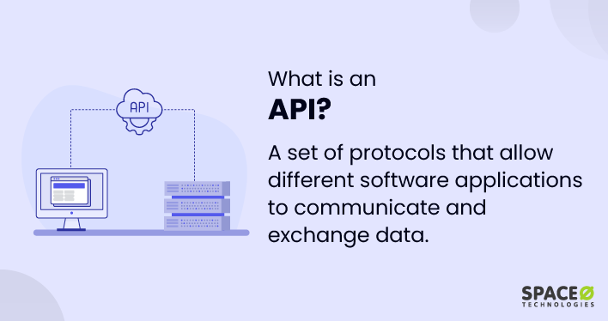
What is an API

Slide 4
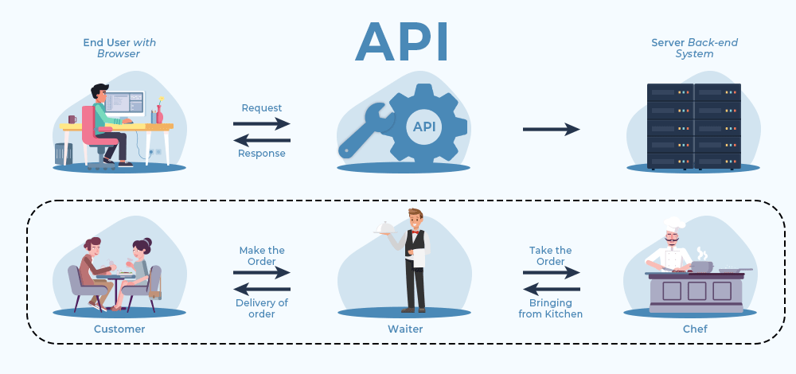
API Explained

Slide 5

Types of API’s

Slide 6
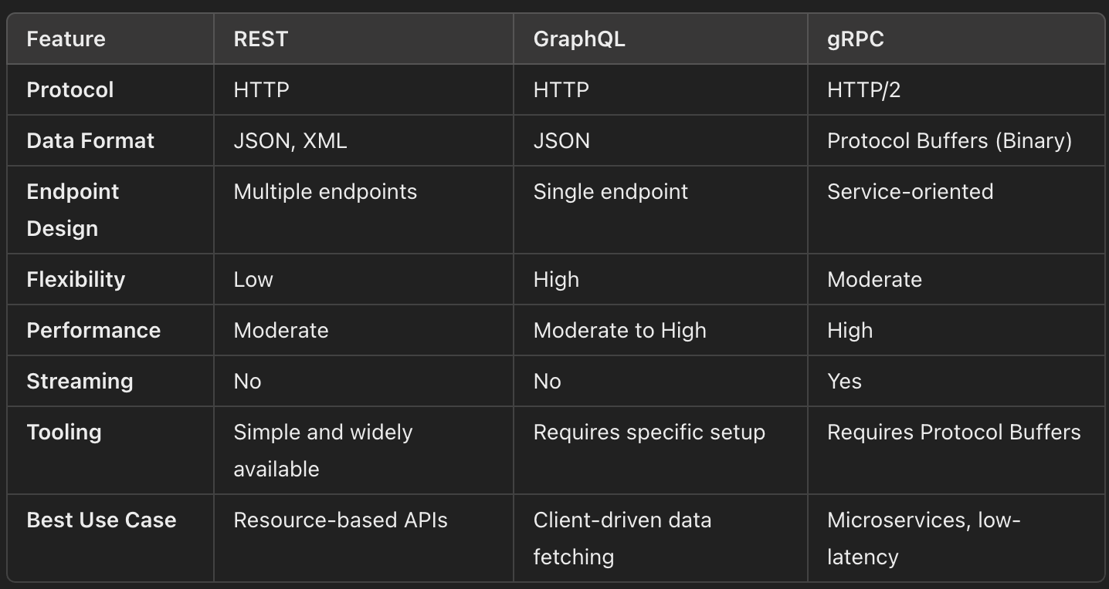
Differences

Slide 7
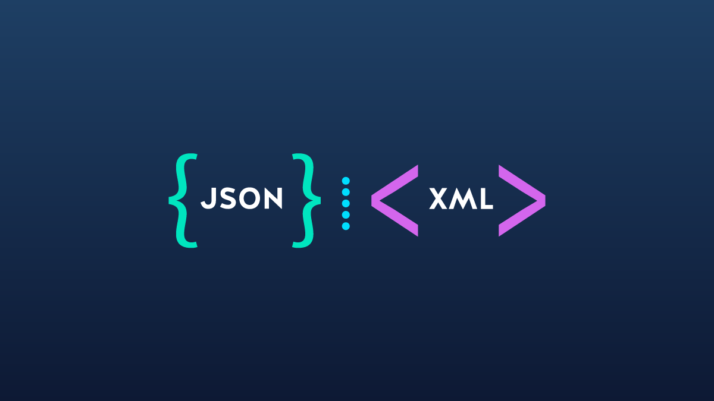
Languages used

Slide 8
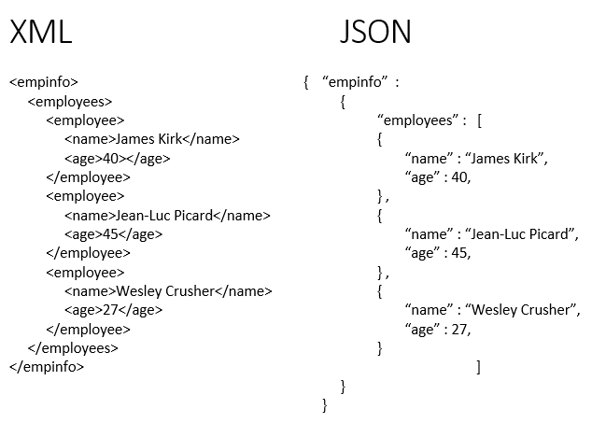
Example

Slide 9
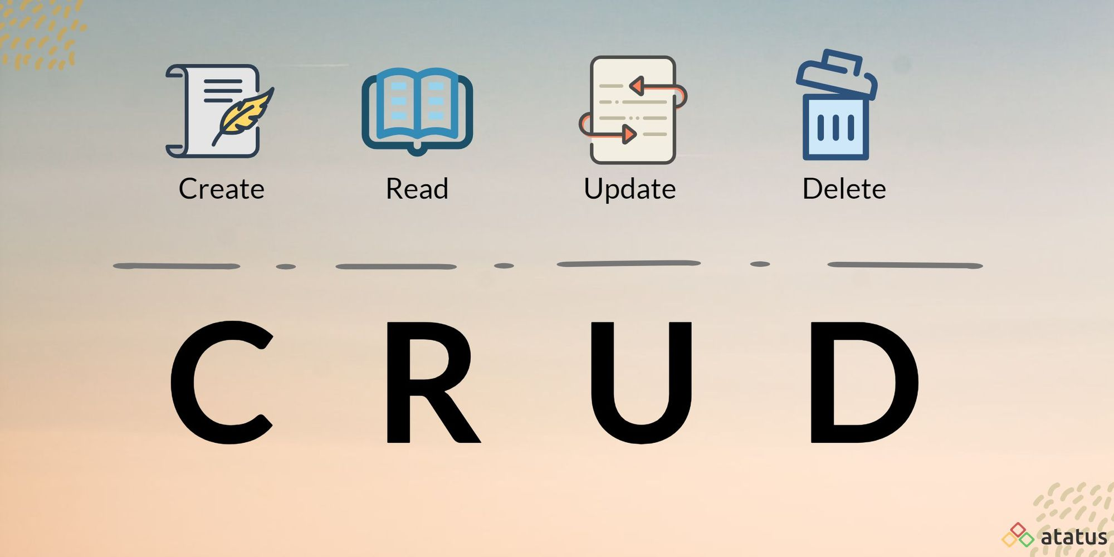
CRUD

Slide 10
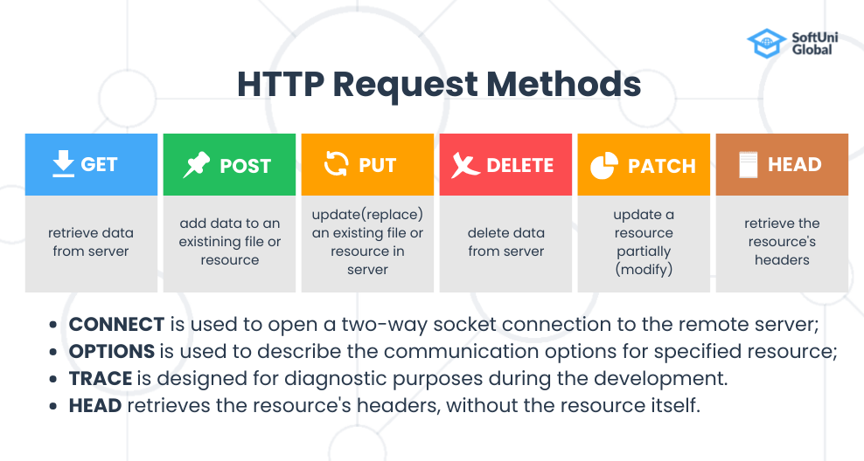
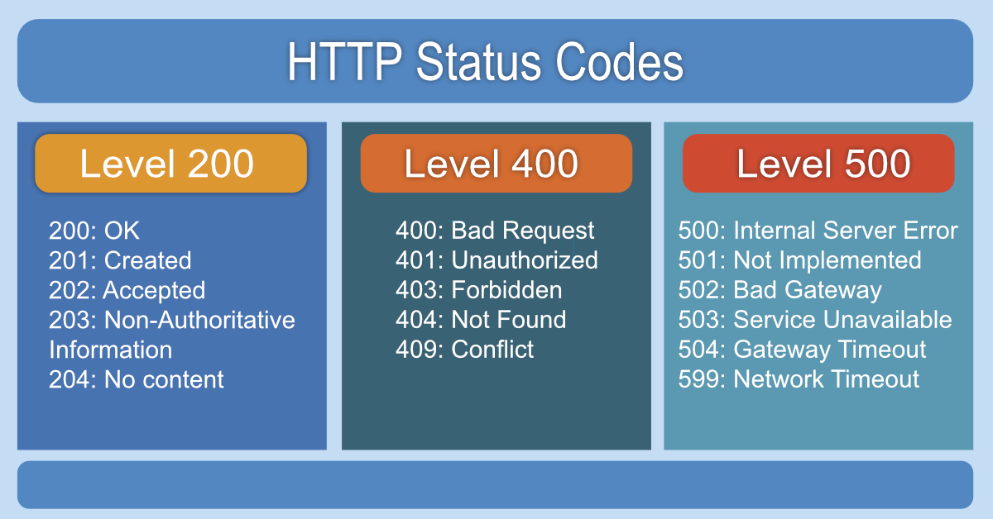
HTTP Methods & Statuses

Slide 11
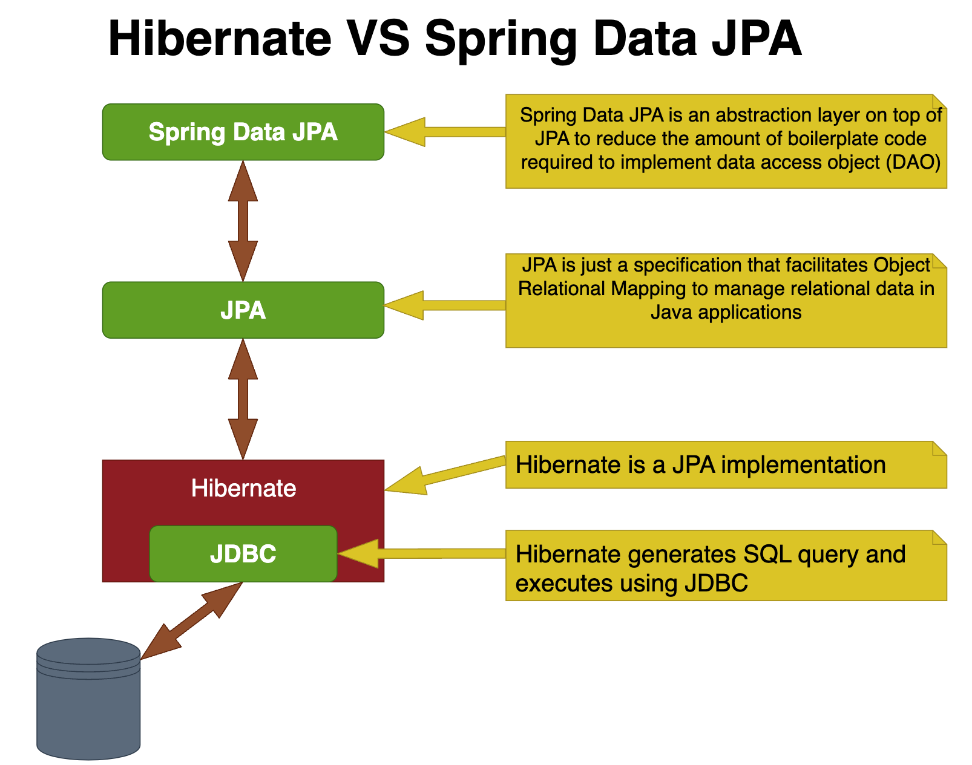
JPA & Hibernate (DB Communication) - ORM

Slide 12
Spring Initialzr
Spring Web
Spring Data JPA
H2 Database

Slide 13
Vragen?

